Slide 1



AMITY UNIVERSITY · ACTION PLAN & ROADMAP
Enterprise File Storage
Modernization
Centralized Digital Asset Management Platform
One Platform
Governed
Secure by Design

Slide 2


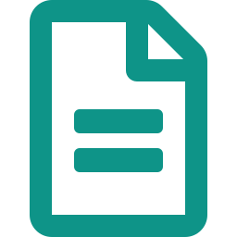



WHY THIS INITIATIVE?
A digital footprint that has outgrown its storage
50+
50+
1,500+
Multiple
Millions
Enterprise
Applications
Websites
Promotional
Pages
Mobile
Applications
Digital
Assets
All of this needs one thing: centralized governance.
Enterprise File Storage Modernization
2 / 19

Slide 3






CURRENT SITUATION
Storage is fragmented across every team
Decentralized storage
TODAY: SCATTERED
Assets live in silos with no single home
Different folder structures
Every team invents its own hierarchy
Different security practices
Inconsistent access and permissions
No visibility
Nobody can see what exists where
No connections. No common ground.
No standards
No naming, sizing or retention rules
Enterprise File Storage Modernization
3 / 19

Slide 4



KEY CHALLENGES
Five gaps standing in the way
Governance
Security
Visibility
No central ownership or policy
Uneven protection of assets
No insight into usage or growth
Standardization
Scalability
No shared rules or conventions
Hard to grow with demand
Enterprise File Storage Modernization
4 / 19

Slide 5





THE SOLUTION
One platform, organised and secure
Centralized storage
TOMORROW: ORGANISED & SECURE
Every asset in one governed home
Standard folder structure
One shared hierarchy for all teams
Unified security practices
Consistent access and permissions
Full visibility
See every asset and how it's used
Connected. Consistent. Controlled.
Enforced standards
Naming, sizing and retention rules
Enterprise File Storage Modernization
5 / 19

Slide 6





THE COST OF INACTION
Risks of staying as-is
Duplicate storage
Orphan files
Security vulnerabilities
Higher infrastructure cost
Difficult maintenance
Same files copied again and again
Assets nobody owns or tracks
Exposed data and weak access
Paying for waste and sprawl
Every fix is slow and manual
Enterprise File Storage Modernization
6 / 19

Slide 7

OUR VISION
One Enterprise Storage Platform serving every application, website and digital initiative.
Enterprise File Storage Modernization
7 / 19

Slide 8




OBJECTIVES
What success looks like
Centralized Storage
Security
Governance
A single source of truth for assets
Protected, controlled, encrypted
Clear ownership and policy
Monitoring
Scalability
Lower Cost
Live visibility into usage
Grows with the institution
Less duplication and waste
Enterprise File Storage Modernization
8 / 19

Slide 9




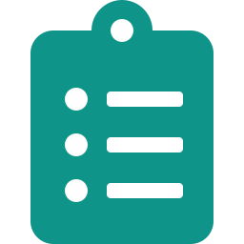

PROPOSED PLATFORM
An object-storage core with built-in capabilities
Bucket Management
Access Keys
Public / Private Policies
Audit Logs
Object
Storage Core
Backup & Recovery
Enterprise File Storage Modernization
9 / 19

Slide 10





GOVERNANCE FRAMEWORK
Rules that keep storage organized over time
01
02
03
04
05
File Categories
Naming Standards
File Size Limits
Retention Policy
Lifecycle Management
Classify every asset by type
One consistent convention
Guardrails on what's stored
How long assets are kept
Archive and retire automatically
Enterprise File Storage Modernization
10 / 19

Slide 11




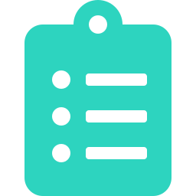
SECURITY FRAMEWORK
Defense in depth, layer by layer
RBAC
Role-based access control for every user
Signed URLs
Time-limited, tamper-proof links
CORS
Controlled cross-origin requests
Encryption
Data protected at rest and in transit
Audit Logs
Every action traceable and recorded
Enterprise File Storage Modernization
11 / 19

Slide 12




DEVELOPER EXPERIENCE
Easy for teams to build on, day one
Standard APIs
Bucket Provisioning
SDKs
Documentation
Consistent, predictable endpoints for every team
Self-service storage in minutes, not weeks
Ready-made libraries for popular languages
Clear guides, examples and references
Enterprise File Storage Modernization
12 / 19

Slide 13


MONITORING DASHBOARD
Live insight into storage health and growth
Storage Usage
Storage Growth (TB)
Upload vs Download (GB/day)
Growth Trends
Upload / Download
Capacity Planning
Enterprise File Storage Modernization
13 / 19

Slide 14





IMPLEMENTATION ROADMAP
Five phases from audit to optimization
PHASE 1
PHASE 2
PHASE 3
PHASE 4
PHASE 5
Audit
Governance
Platform
Migration
Optimization
Map what exists today
Define rules & standards
Build the storage core
Move assets in safely
Tune, monitor, improve
Enterprise File Storage Modernization
14 / 19

Slide 15





12-WEEK TIMELINE
From kickoff to go-live in twelve weeks
W1
W2
W3
W4
W5
W6
W7
W8
W9
W10
W11
W12
Audit
Weeks 1-2
Standards
Weeks 3-4
Development
Weeks 5-8
Migration
Weeks 9-10
Go Live
Weeks 11-12
Enterprise File Storage Modernization
15 / 19

Slide 16




EXPECTED OUTCOMES
What the organization gains
Better Governance
Improved Security
Clear ownership and consistent policy
Assets protected end to end
Reduced Duplication
Simplified Maintenance
One copy, one source of truth
Less manual effort, fewer errors
Future Ready
Built to scale with new initiatives
Enterprise File Storage Modernization
16 / 19

Slide 17

LONG-TERM VISION
Enterprise storage as the foundation for all university digital platforms.
Enterprise File Storage Modernization
17 / 19

Slide 18


SUCCESS METRICS
How we'll measure the win
100%
100%
Real-time
Reduced
Standardized Storage
Central Governance
Monitoring
Operational Complexity
Enterprise File Storage Modernization
18 / 19

Slide 19


THANK YOU
Questions & Discussion
Discussion
Q & A

